Slide 1


AIR QUALITY INDEX OF INDIAN CITIES
DATA ANALYSIS AND BENFORD’S LAW
TEAM NAME: ROOM_113
Shivank Gupta – krish.gupta@adypu.edu.in
Atharv Paharia – atharv.paharia@adypu.edu.in
Kshitij Saxena – kshitij.saxena@adypu.edu.in
Vinayak Singh – vinayak.singh01@adypu.edu.in

Slide 2


Goal: Analyze AQI trends and check conformity to Benford’s Law.
PROJECT OVERVIEW
Tools: Python (Pandas, Seaborn, Matplotlib)
Dataset: 100+ Indian cities – PM2.5, PM10, NO₂, etc.
Steps: Cleaning, EDA, Benford’s Law Analysis
2

Slide 3

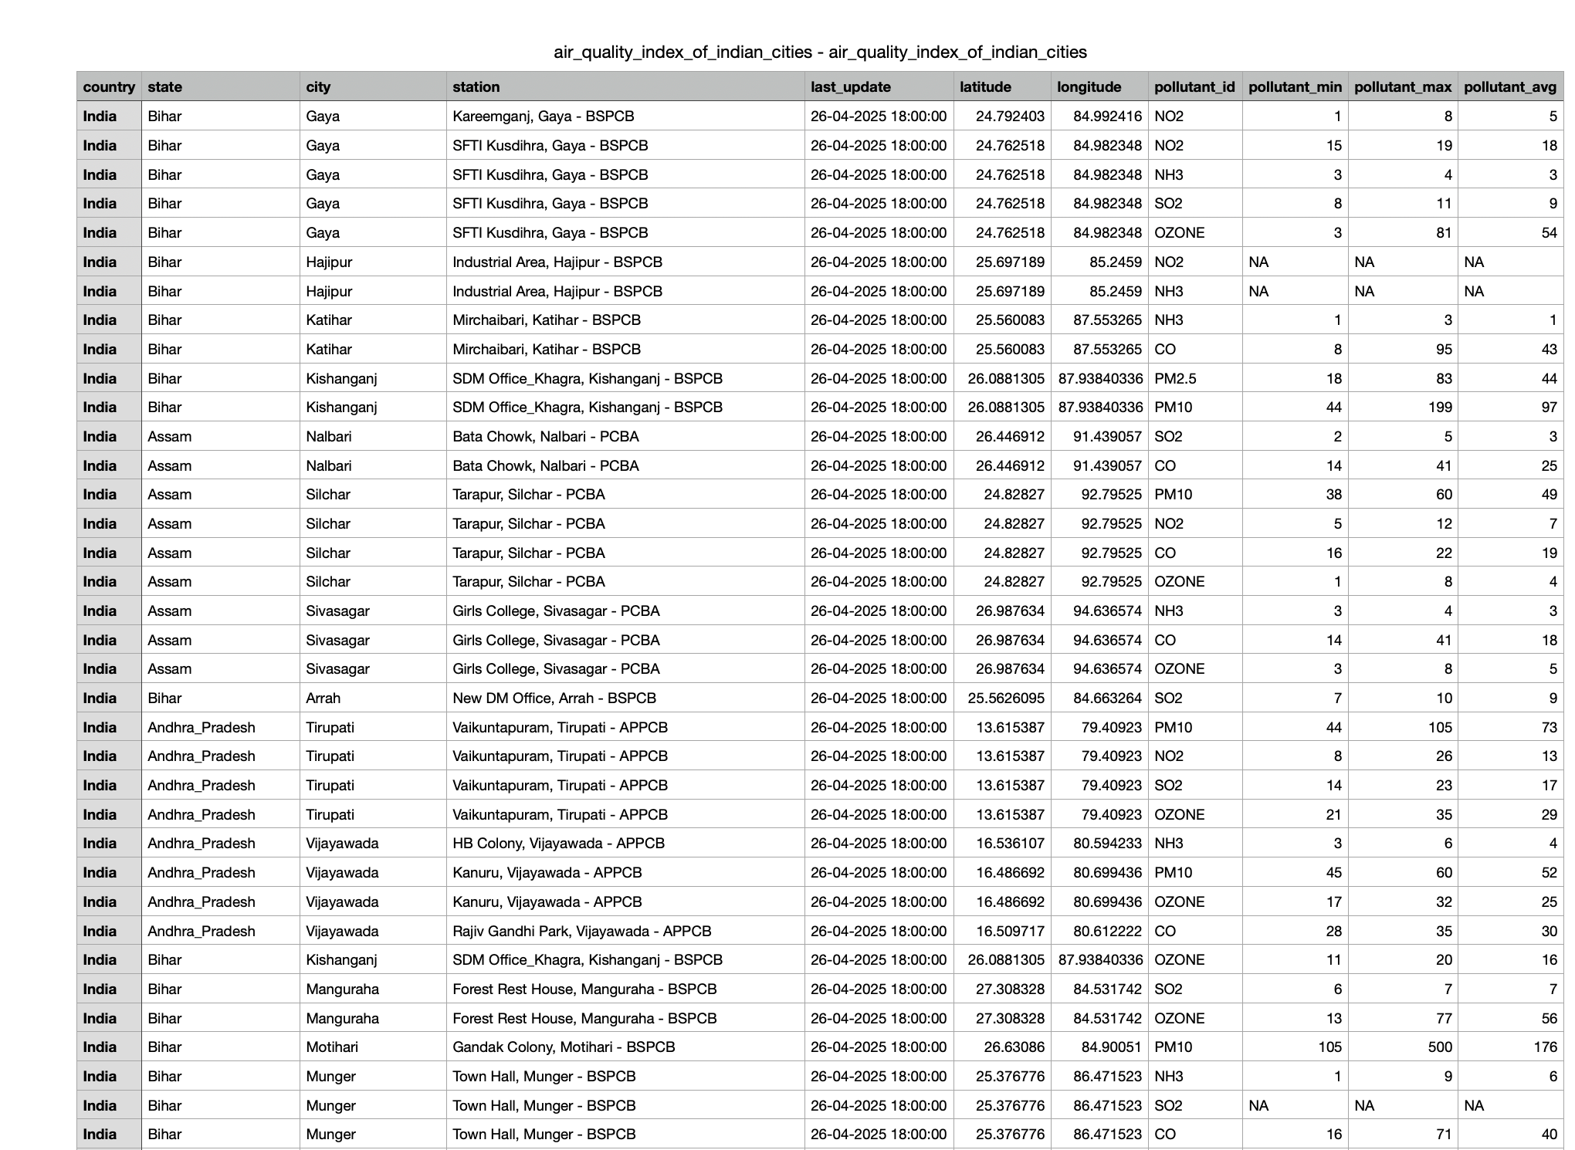
DATASET SNAPSHOT
3

Slide 4
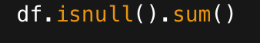

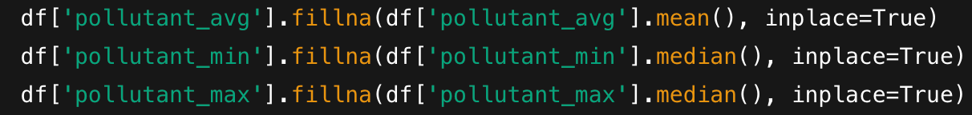
DATA PREPROCESSING
➤ Checked for Missing Values:
➤ Descriptive Statistics:
➤ Descriptive Statistics:
4

Slide 5

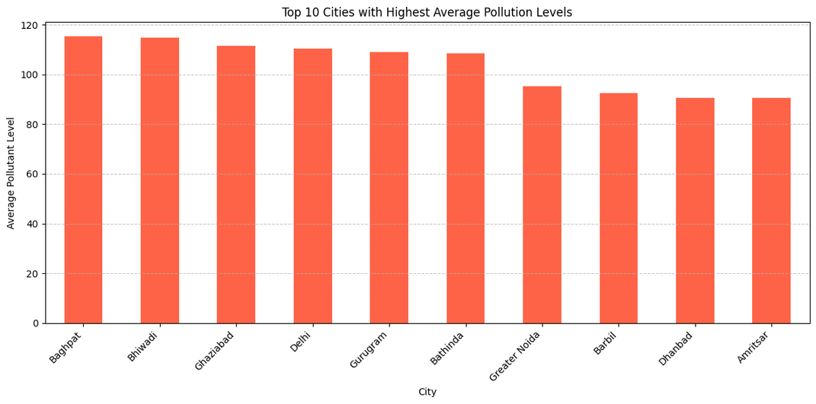
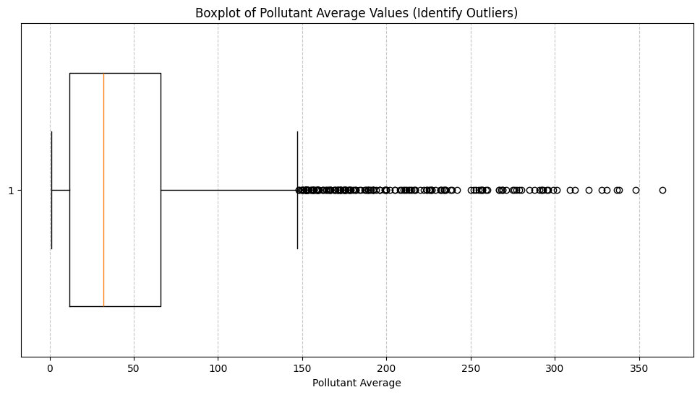
EXPLORATORY DATA ANALYSIS (EDA)
Top 10 cities by pollutant_avg (Bar Plot)
Boxplots of Pollutant Average Values₂
Insights: Delhi and Bihar cities have high AQI
5

Slide 6
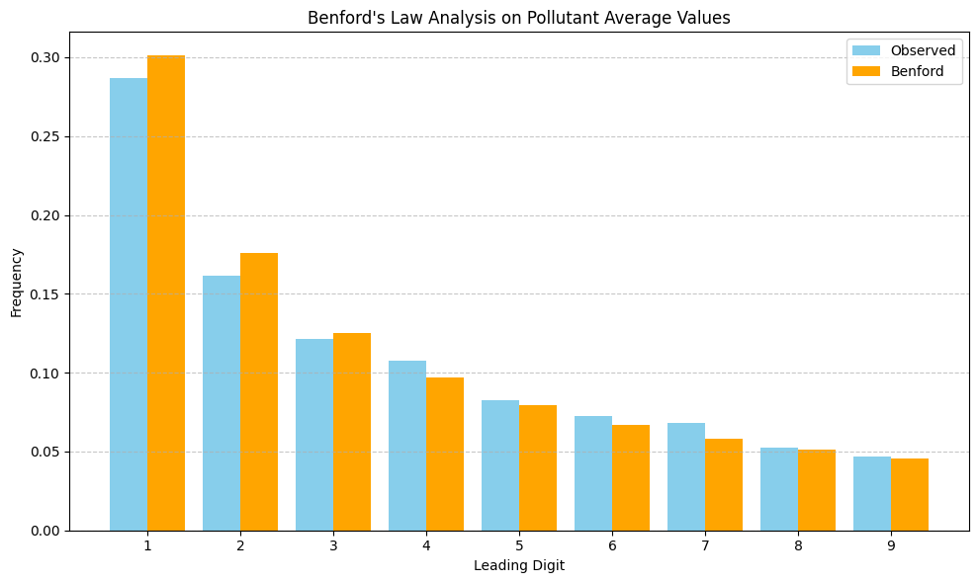
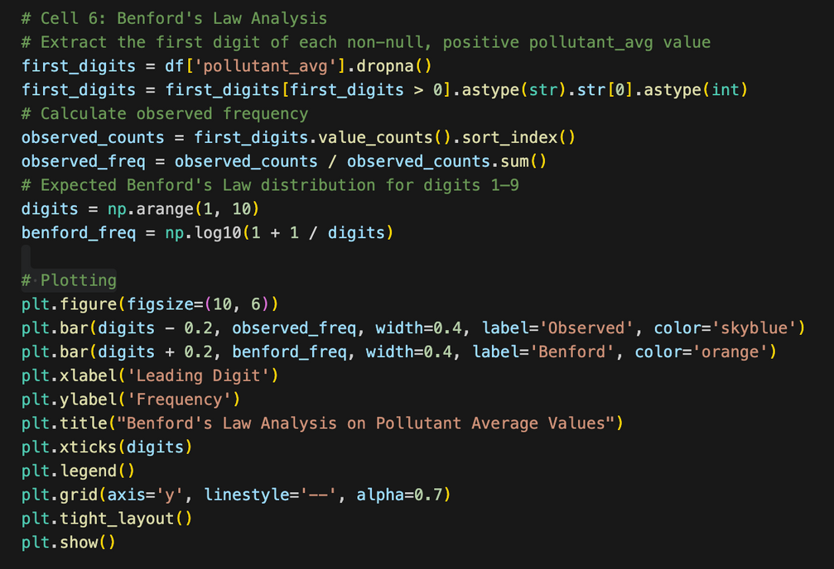
BENFORD’S LAW APPLICATION
Result: Partial adherence due to
AQI skewness
6

Slide 7

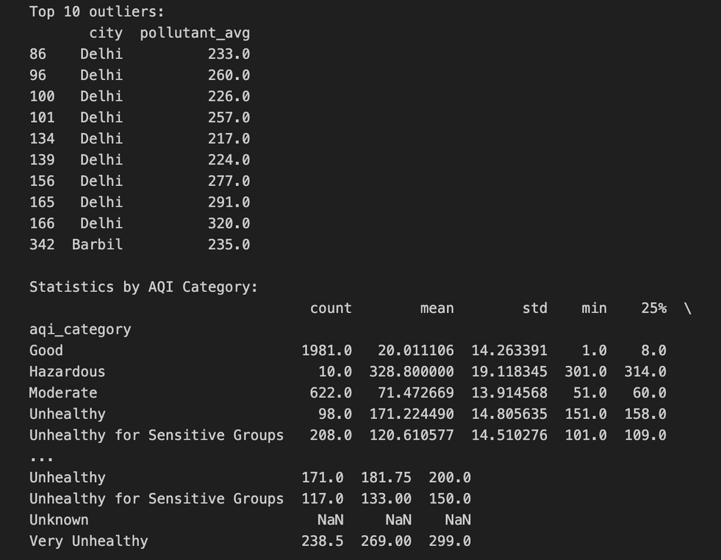
KEY FINDINGS
➤Northern cities like Delhi and Bihar are
highly polluted
➤PM2.5 and PM10 are major contributors
➤Benford’s Law holds partially for AQI data
7

Slide 8
CHALLENGES & SOLUTIONS
➤Missing Data
➤Handled with median
values
➤Outliers
➤Treated using IQR
method
➤Graph Clarity
➤Used Seaborn for better
visuals
➤Limited Data Scope
➤Focused on valid entries
8

Slide 9

INDIVIDUAL CONTRIBUTIONS
Atharv Paharia
Acted as the Team Leader, coordinating tasks and timelines.
Provided support to both Shivank (Notebook) and Kshitij (PPT) in refining and finalizing their work.
Shivank Gupta
Created the complete Jupyter Notebook (IPYNB)
file.
Performed data analysis and integrated the logic of Benford’s Law.
Kshitij Saxena
Designed and created the PowerPoint (PPT) presentation for the project.
Summarized the findings and helped visualize key insights from the analysis.
Vinayak Singh
Helped in debugging and refining the Jupyter
Notebook.
Assisted with code corrections and ensuring smooth execution of the notebook.
9

Slide 10
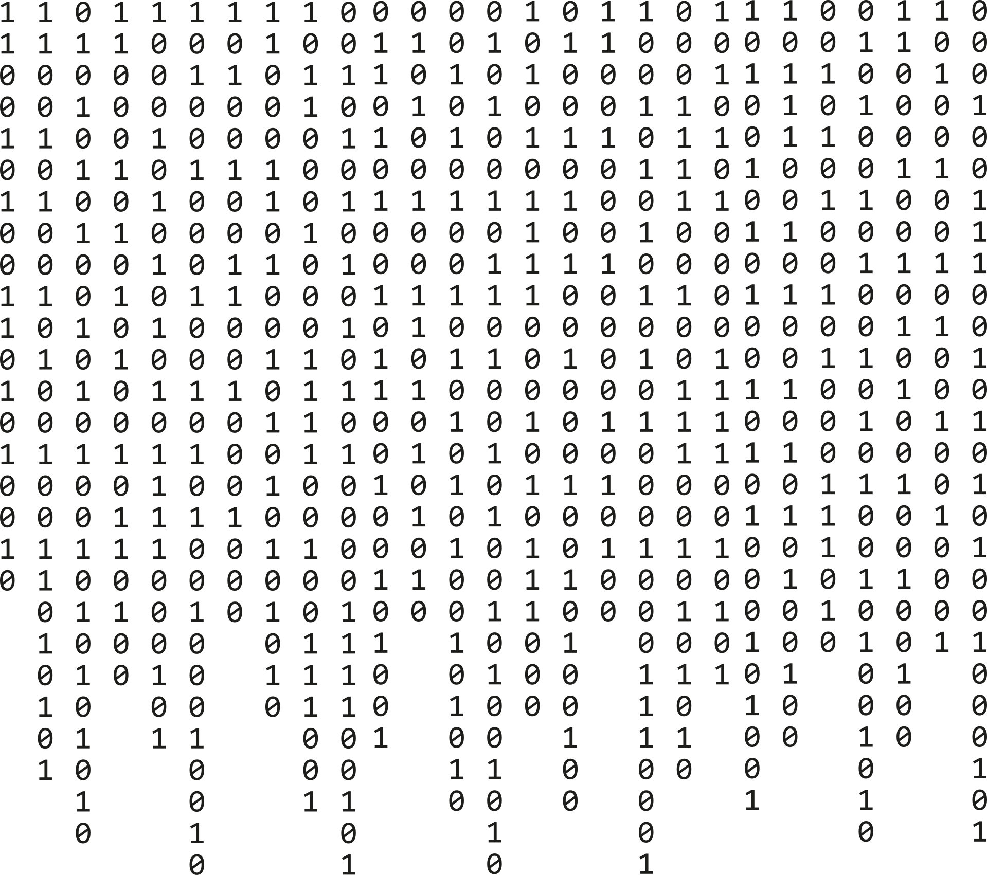
THANK YOU !

